Slide 1
Games Audio Project Slides
By Jack Morris

Slide 2
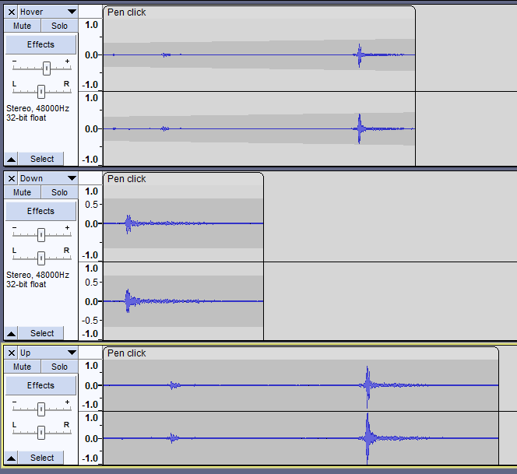
Menu BUTTONS (SoUND CreatioN)
Original sound was a Pen Click
Amplified by 11.1dB
Low Pass Filter EQ to remove jitters
Split into 3 separate audios files for each sound effect
Pitch altered to give variety
Added Envelope to hover sound to lower attack time

Slide 3
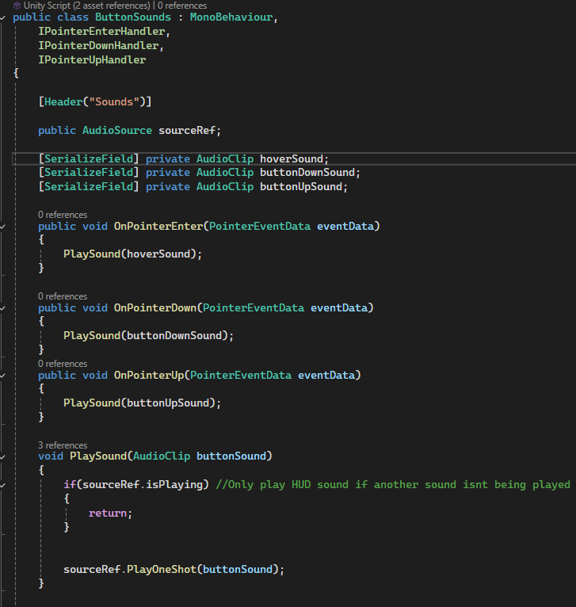
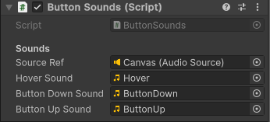
Menu BUTTONS (IMPLEMENTATION)
Uses Event Handler Interfaces to work out when the mouse enters, clicks on or is released on a button.
Plays the relevant sound effect
Audio Source is attached to Canvas
The Script is attached to all buttons on the Canvas

Slide 4
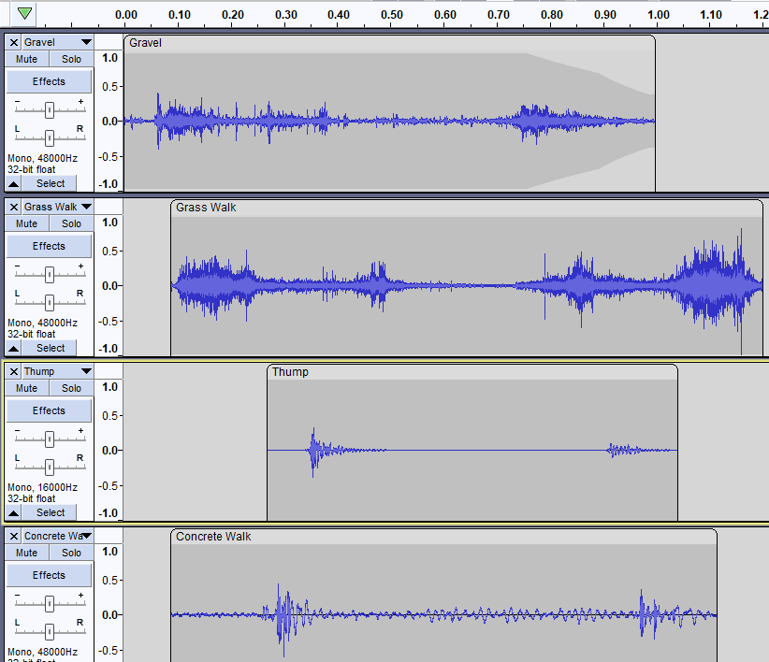
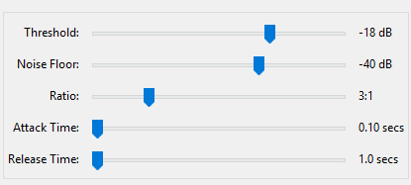
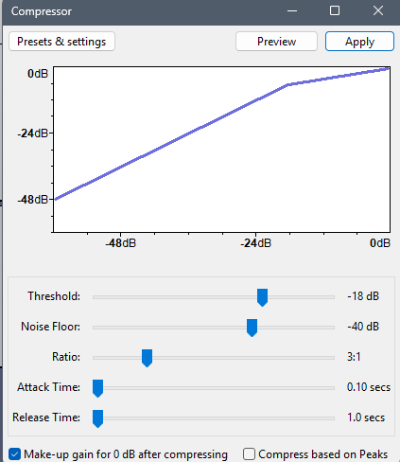
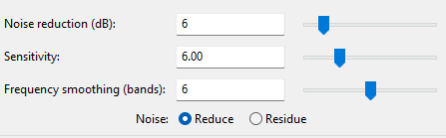
Footsteps (SoUND Creation)
GRASS FOOTSTEPS (Grass Walk):
Trimmed Audio down to one footstep
Amplified audio by 5dB
Compressed Audio to add impact:
High Pass Filter to emphasise crunch of grass
Noise Reduction to remove car passing:
PATH FOOTSTEPS (Gravel):
Trimmed Audio down to one footstep
High Pass Filter to remove background noise
(100 Hz, 12dB)
Compressed Audio to add impact:
Normalised perceived loudness to -23 dB
Applied Envelope to trail off audio

Slide 5
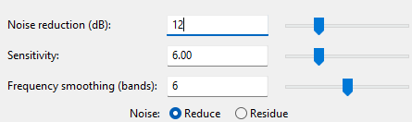
Footsteps (SoUND Creation)
STONE FOOTSTEPS (Concrete Walk):
Trimmed down to one footstep
Amplified Audio by 13dB
Low pass filter to remove any birds / grass crunches (900 Hz, 6 dB)
Noise Reduction to remove any remaining bird noises
THUMP SFX:
Used in all 3 footstep tracks to simulate the weight of the player
Pitch lowered for the Stone Footsteps
Amplified by 17 dB
Compressed to increase impact
Normalised perceived noise to -30dB (quieter than footstep audio tracks)

Slide 6
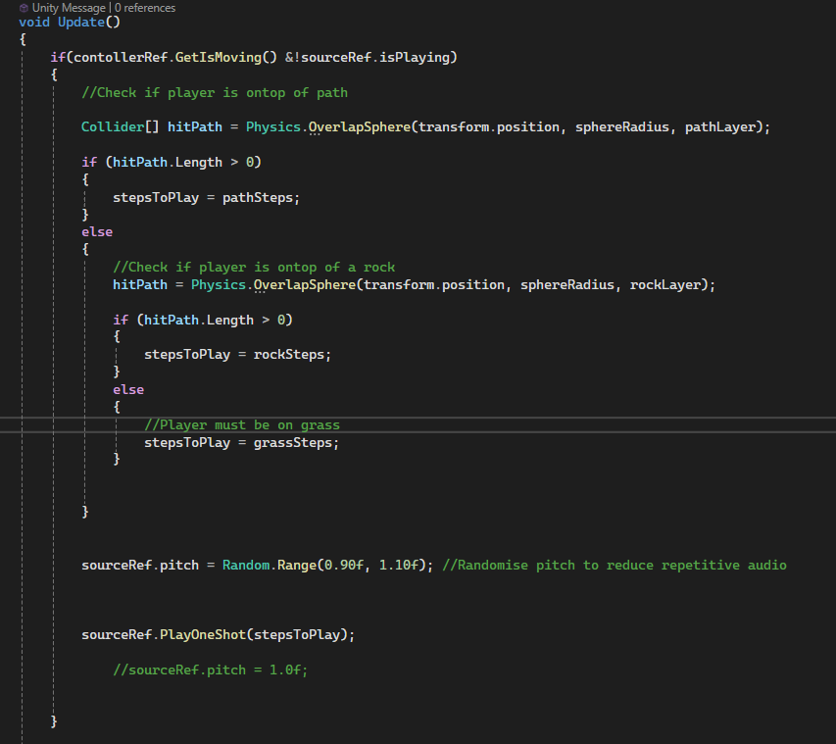
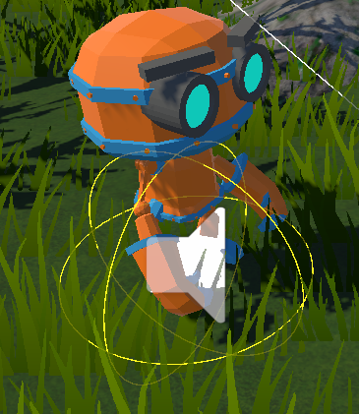
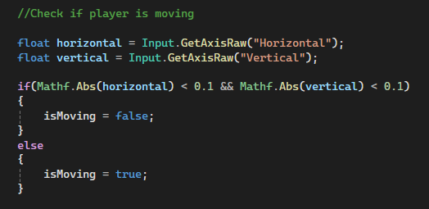
Footsteps (Implementation)
Uses Physics.OverlapSphere to check what material the player is standing on (using Layer Masks)
Swaps the sound played to the corresponding material whenever the player leaves / enters a material hitbox
Slightly randomises pitch of sound effects played to reduce repetitiveness
Overlap Sphere hitbox visible in Editor using ShowGizmos()
Logic used to check if player is moving in PlayerController Update()

Slide 7
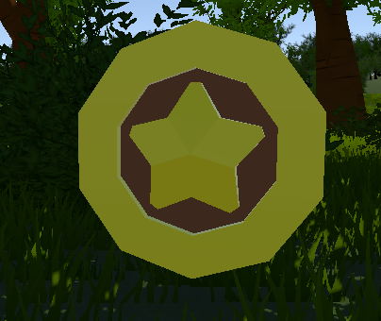
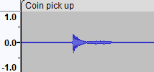
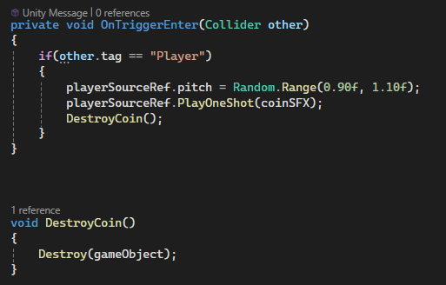
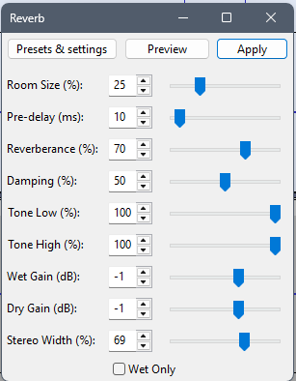
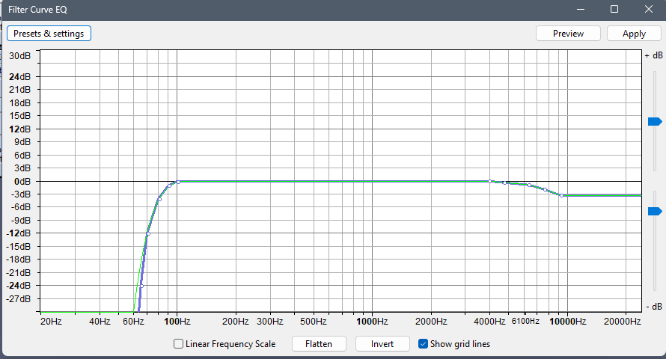
PICK UPS (COIN SFX)
Original sound was the sound a glass being flicked
Trimmed audio clipped to only feature best ping
Applied Reverb:
Raised pitch by 3 semitones
Filter Curve EQ to remove background noise:
Checks for player collision using tag
Plays sound effect with randomised pitch
Destroys the Coin Game Object

Slide 8
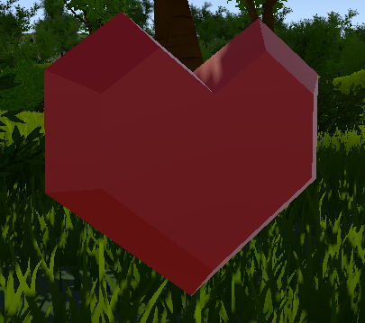
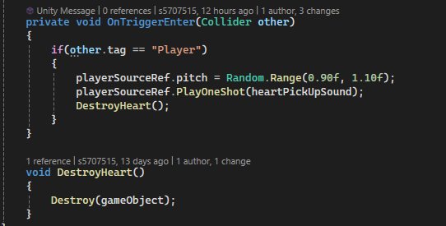
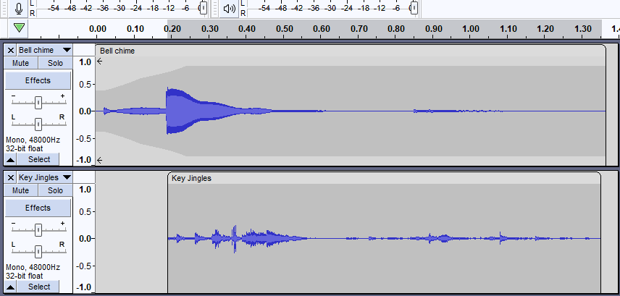
PICK UPS (Heart SFX)
Similar C# code to Coin SFX
BELL CHIME
Trimmed clip to one chime
Amplified by 4 dB
Enveloped start to lower attack time of clip
KEY JINGLES
Trimmed clip
Applied fade out to end of clip
Filter Curve EQ to remove harsh key sounds

Slide 9
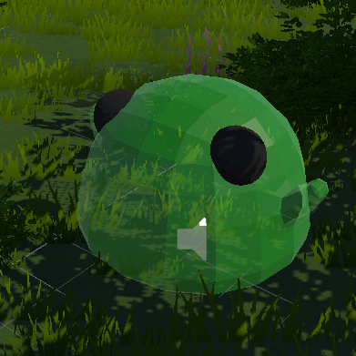
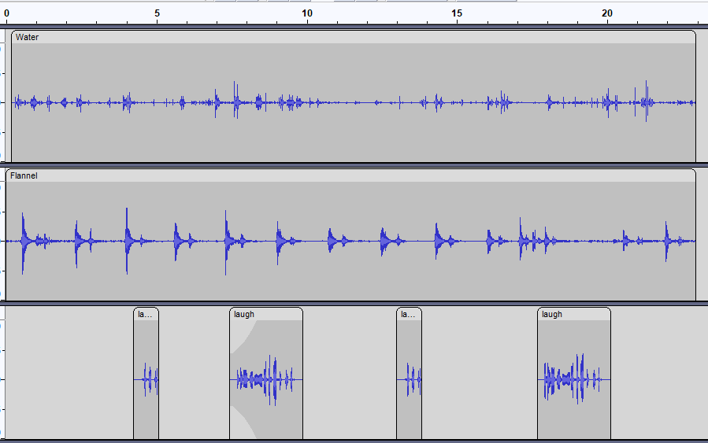
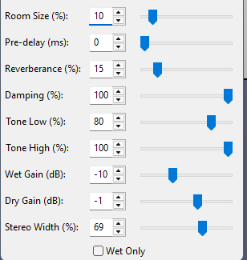
SLIME (SoUND CreatioN)
FLANNEL:
Amplified by 7 dB
Low pass filter to remove high squeaks (7000 Hz cutoff, 24 dB roll off)
Adjusted tempo by -10% (slimier feel)
Added subtle reverb:

Slide 10
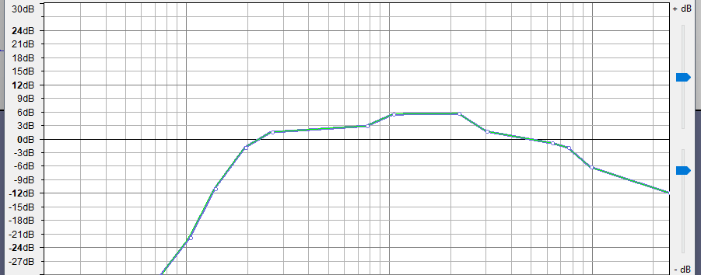
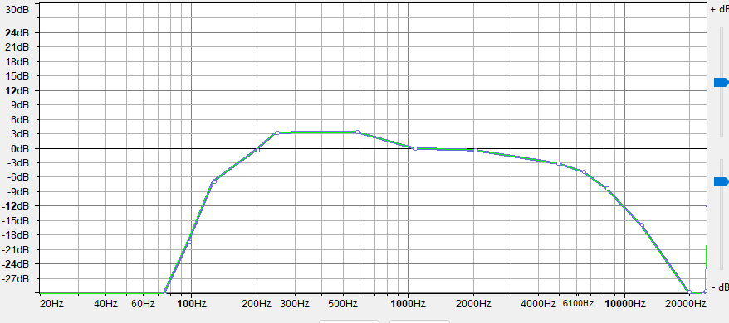
SLIME (SoUND CreatioN)
WATER:
Trimmed down to ~20s
Applied Filter Curve EQ to make water sound “slimier”
Amplified by 2 dB
Positioned in a way so that on average the water ripples peak after the flannel peaks
LAUGH:
Slowed tempo down by 30%
Filter Curve EQ to boost middling pitches
Duplicated audio clip, reverse and trimmed to add giggle variation
Lowered pitch by a semitone
Inverted and pitched up by ½ a semitone for another laugh
Enveloped one of he laughs which sounded too harsh

Slide 11
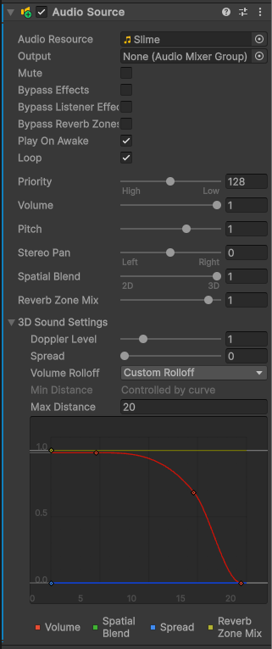
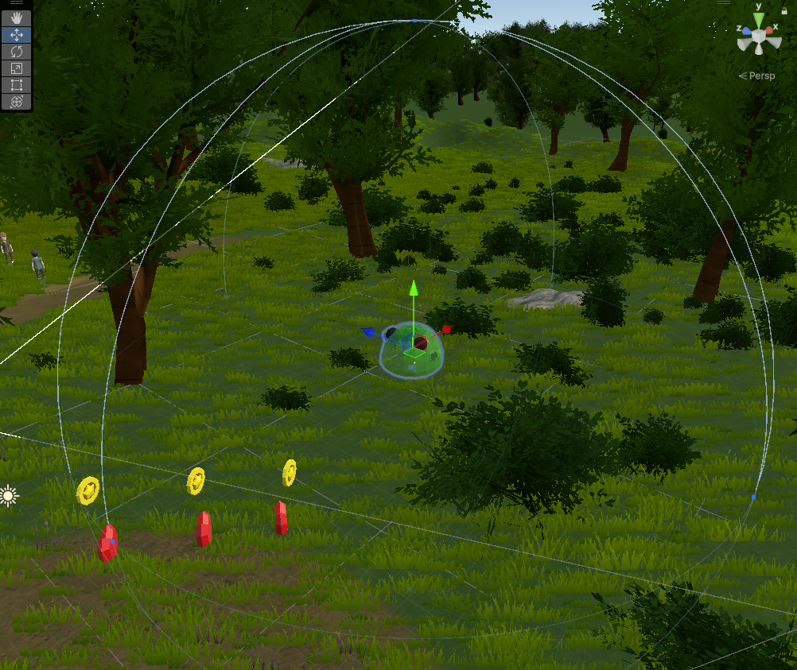
SLIME (IMPLEMENTATION)
Sound effect constantly loops in 3D space
Audio gets quieter the further away the player is to the slime
Roll off rapidly decreases volume after player gets a certain distance away from the slime
Range which the Slime SFX can be heard from

Slide 12
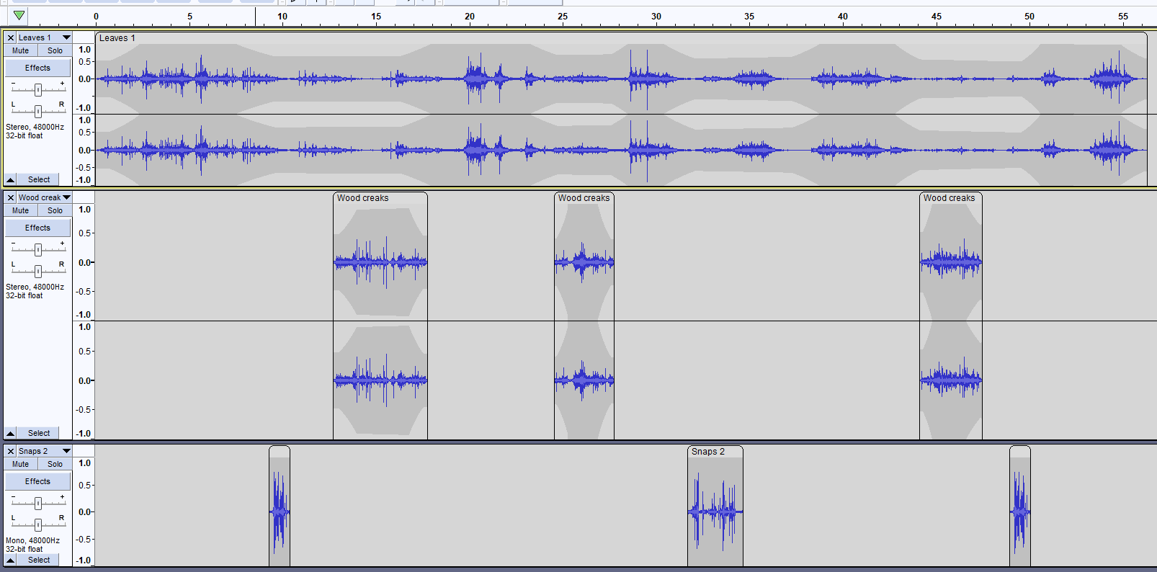
AMBIENCE (SoUND CreatioN)

Slide 13
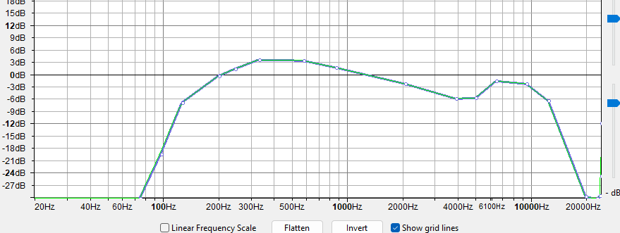
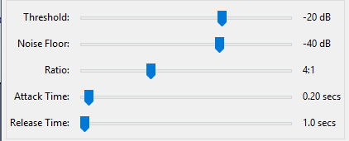
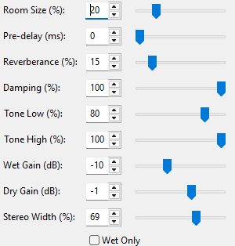
AMBIENCE (SoUND CreatioN)
SOUND EFFECT | MODIFICATIONS
LEAVES 1 | High pass filter to remove any low rumbling (120 Hz cutoff, 12 dB) Graphic EQ to slightly boost audio between 3 and 6 KHz Normalised volume to -1 Duplicated clip (40% left + 40% right) and combined clips into a stereo file Used envelope tool to mimic wind bursts There are also bird tweets in the background
WOOD CREAKS | Compressed audio to reduce sound difference High pass at 120 Hz to remove low rumbling Filter Curve EQ to boost wood creaking pitch Added Subtle Reverb Noise Reduction to remove cars passing Pitch Lowered by 1 semitone Converted clip to stereo file Place clips so they didn’t peak at the same time as leaves Enveloped wood creak (natural feel)

Slide 14
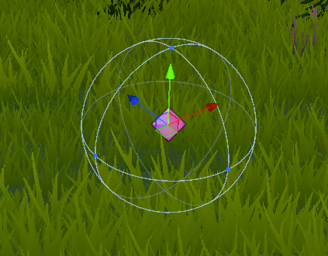
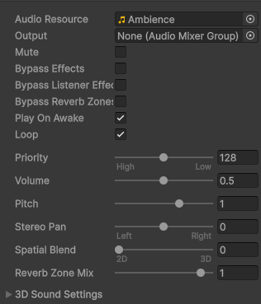
AMBIENCE (Sound Creation + IMPLEMENTATION)
SOUND EFFECT | MODIFICATIONS
SNAPS 2 | Trimmed down clip, duplicated and split into multiple parts High Pass Filter at 120 Hz Noise Reduction to remove background static
Constantly loops
Uses 2D space so that the volume remains at the same level throughout the game space
Lowered volume so that other sound effects aren’t drowned out
Empty Game Object which holds the Ambience Audio Source

Slide 15
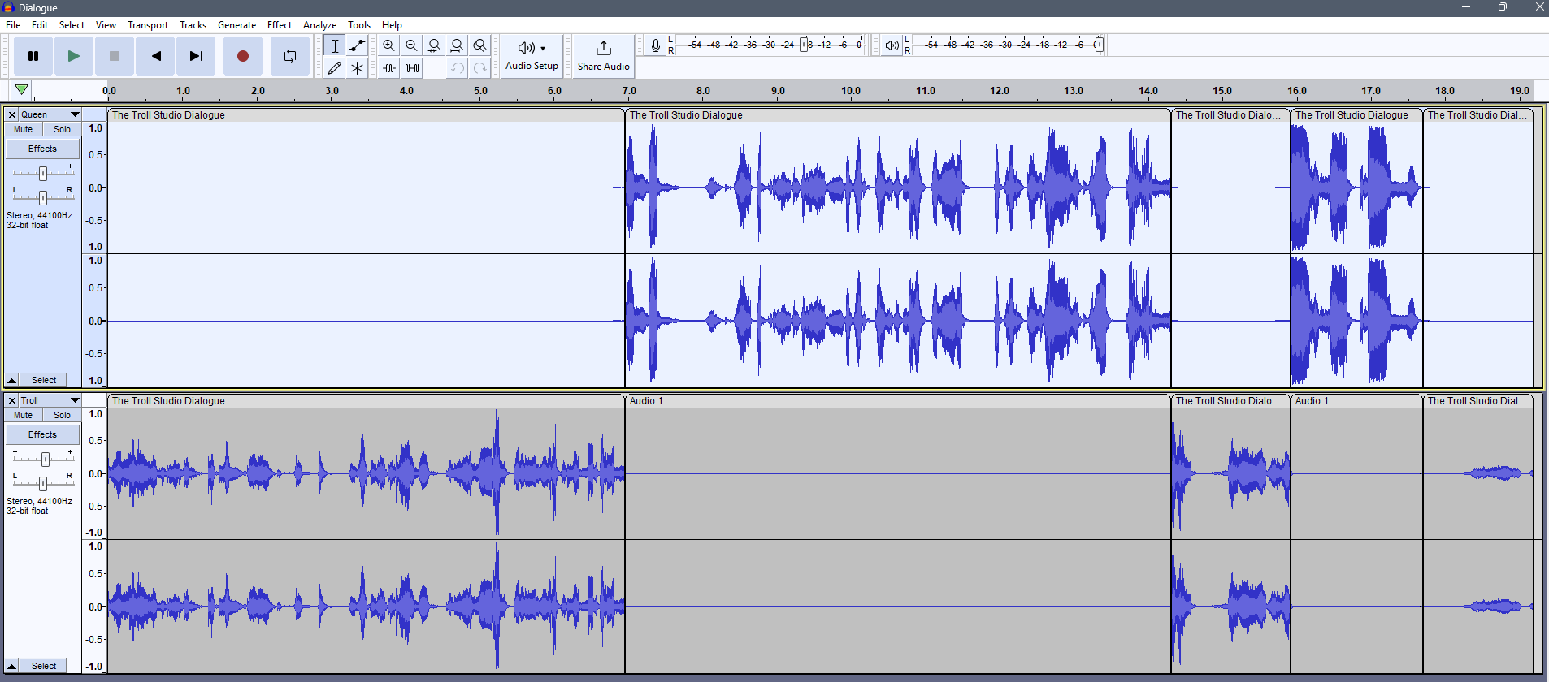
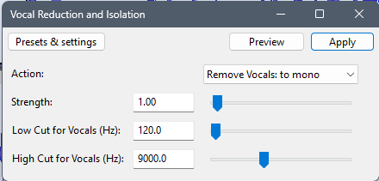
Dialogue
Cut off any unnecessary audio
Applied Voice Isolation to lower background noise and switched to mono
Split audio for characters into two separate audio files

Slide 16
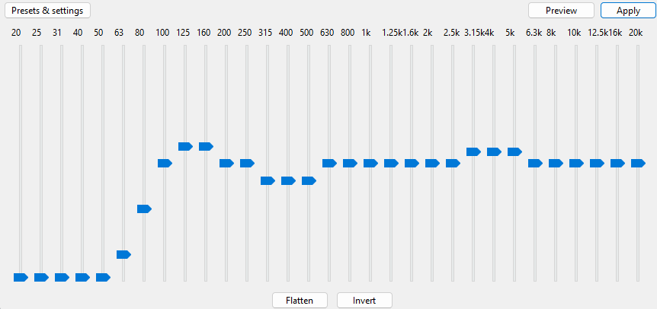
Dialogue (TROLL)
Amplified audio by 5 dB to match female voice in volume
Graphic EQ to enhance male voice and reduce background hum

Slide 17
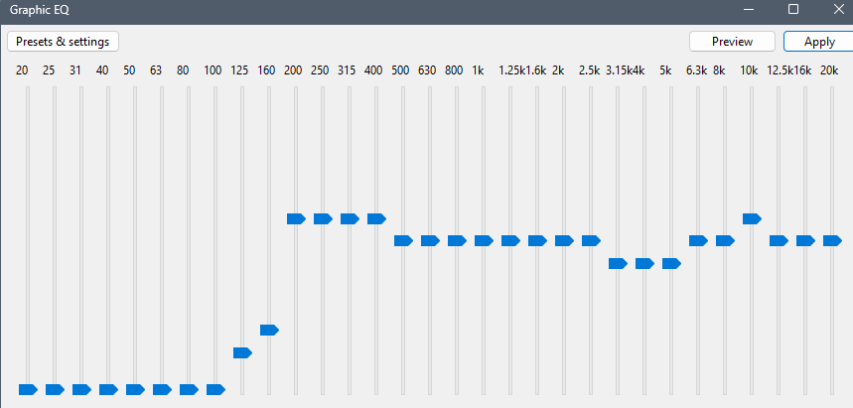
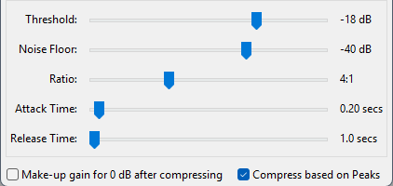
Dialogue (QUEEN)
Graphic EQ used to enhance female voice and remove background hum
Compressed volume of the loud parts to remove peaking of the microphone

Slide 18
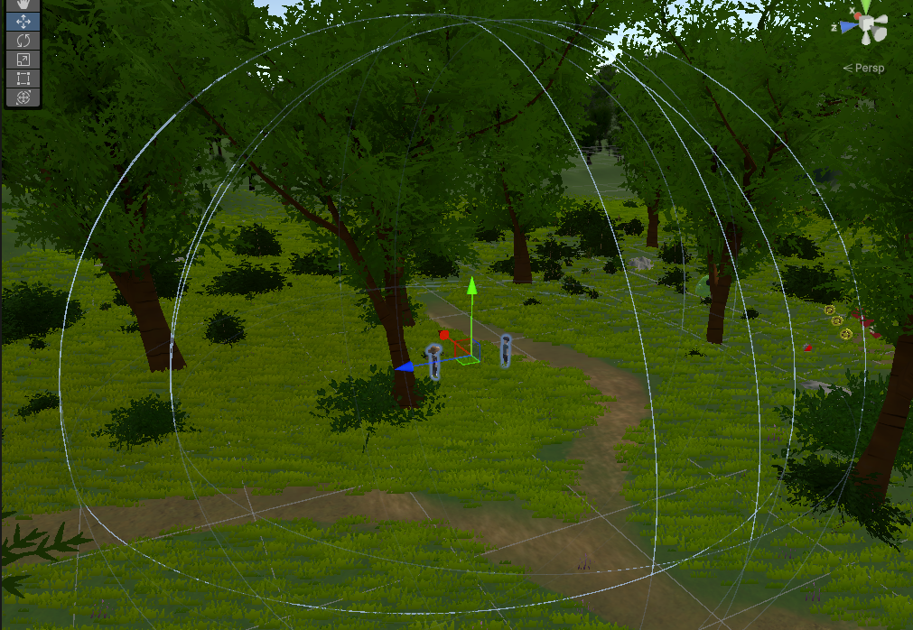
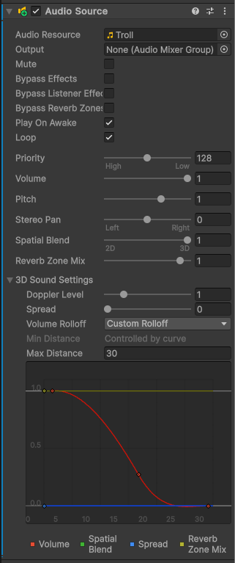
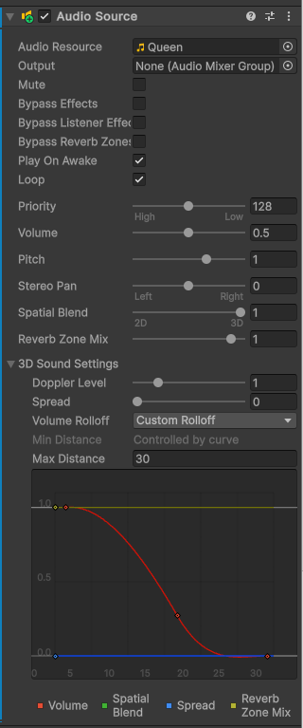
Dialogue (IMPLEMENTATION)
Range which audio can be heard
(slightly larger than slime range)
2 separate audio sources, one for queen one for troll
3D spatial blend with custom roll off to create localised sound
Queen has lower volume as dialogue ended up louder

Slide 19
Hand-MADE Sounds
File Name | How sound was created
Penclick.mp3 | By pressing the button on a retractable pen
Gravel.m4a | By walking on loose shingle
Thump.m4a | Banging on the underside of a table
GrassWalk.m4a | By walking on long grass
ConcreteWalk.m4a | By walking on garden paving slabs
CoinPickUp.m4a | Flicking the upper part of a glass
Snaps2.m4a | Stepping on shed eucalyptus bark
File Name | How sound was created
BellChime.mp3 | Gently ringing an old garden bell
Keys.mp3 | Gently shaking a keychain of keys together
Flannel.m4a | Rinsing a wet flannel and squeezing it repeatedly
Water.m4a | Breaking surface tension of water using fingers
Leaves1.m4a | Gently shaking a bush in the wind. Includes bird’s tweets as background noise
WoodCreak.m4a | Shaking a pile of chopped branches together

Slide 20
Sound ORIGINS
Most sounds were recorded by me and are listed on the Recording Details Template
The Laugh.ogg Sound Effect used for the slime laughing can be found here: https://opengameart.org/content/tiny-creatures-sounds

